Slide 1

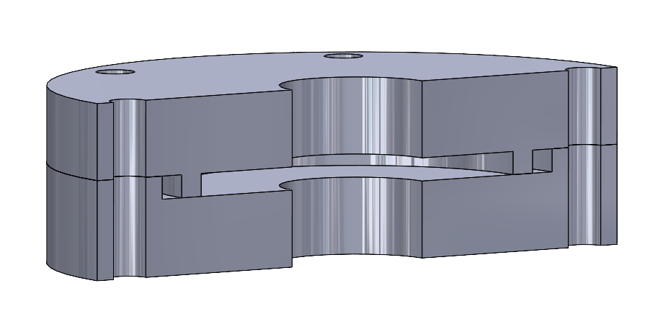
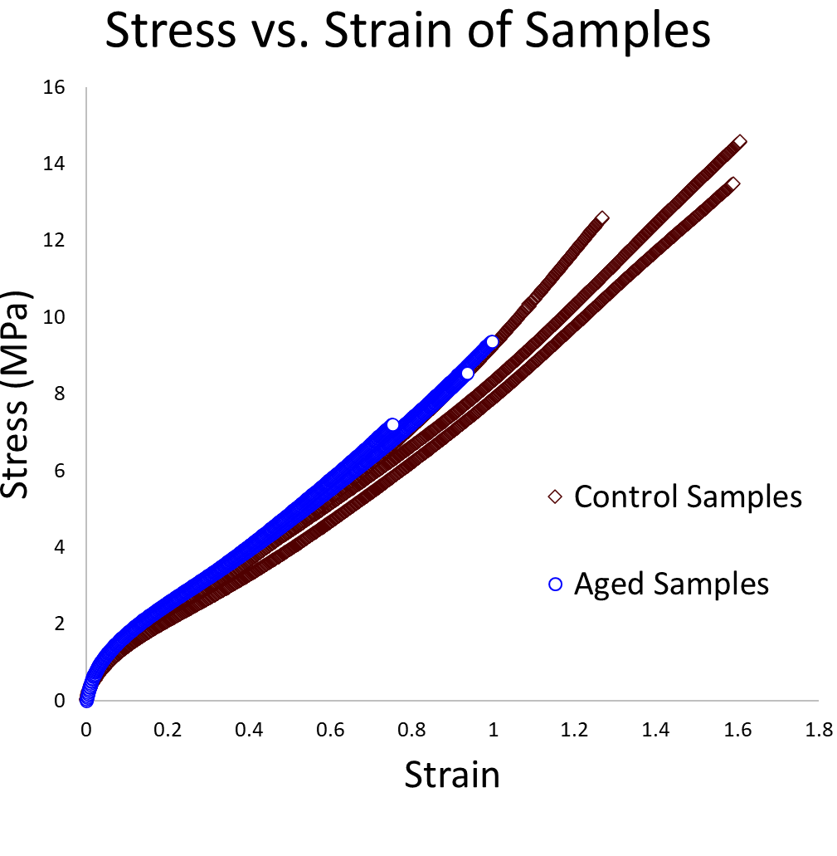
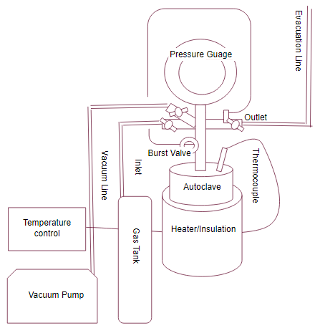
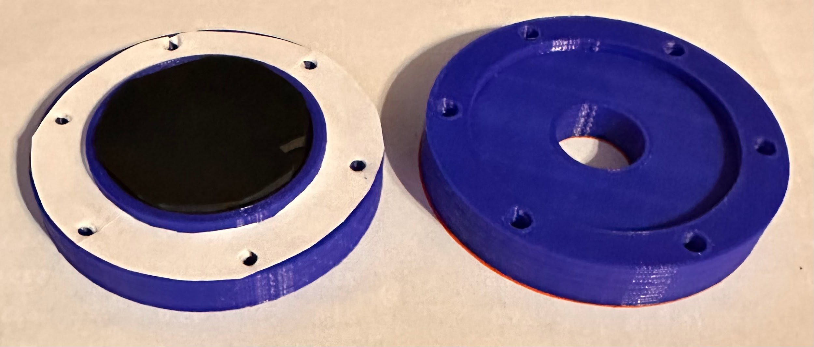
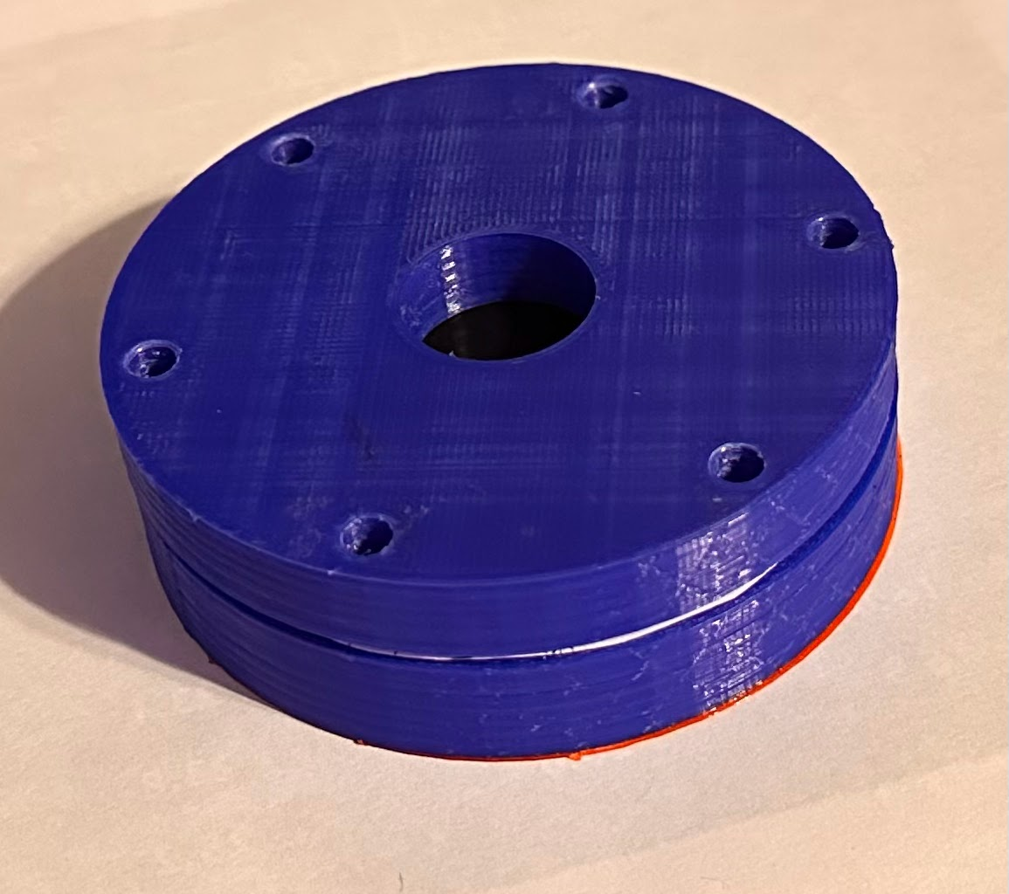
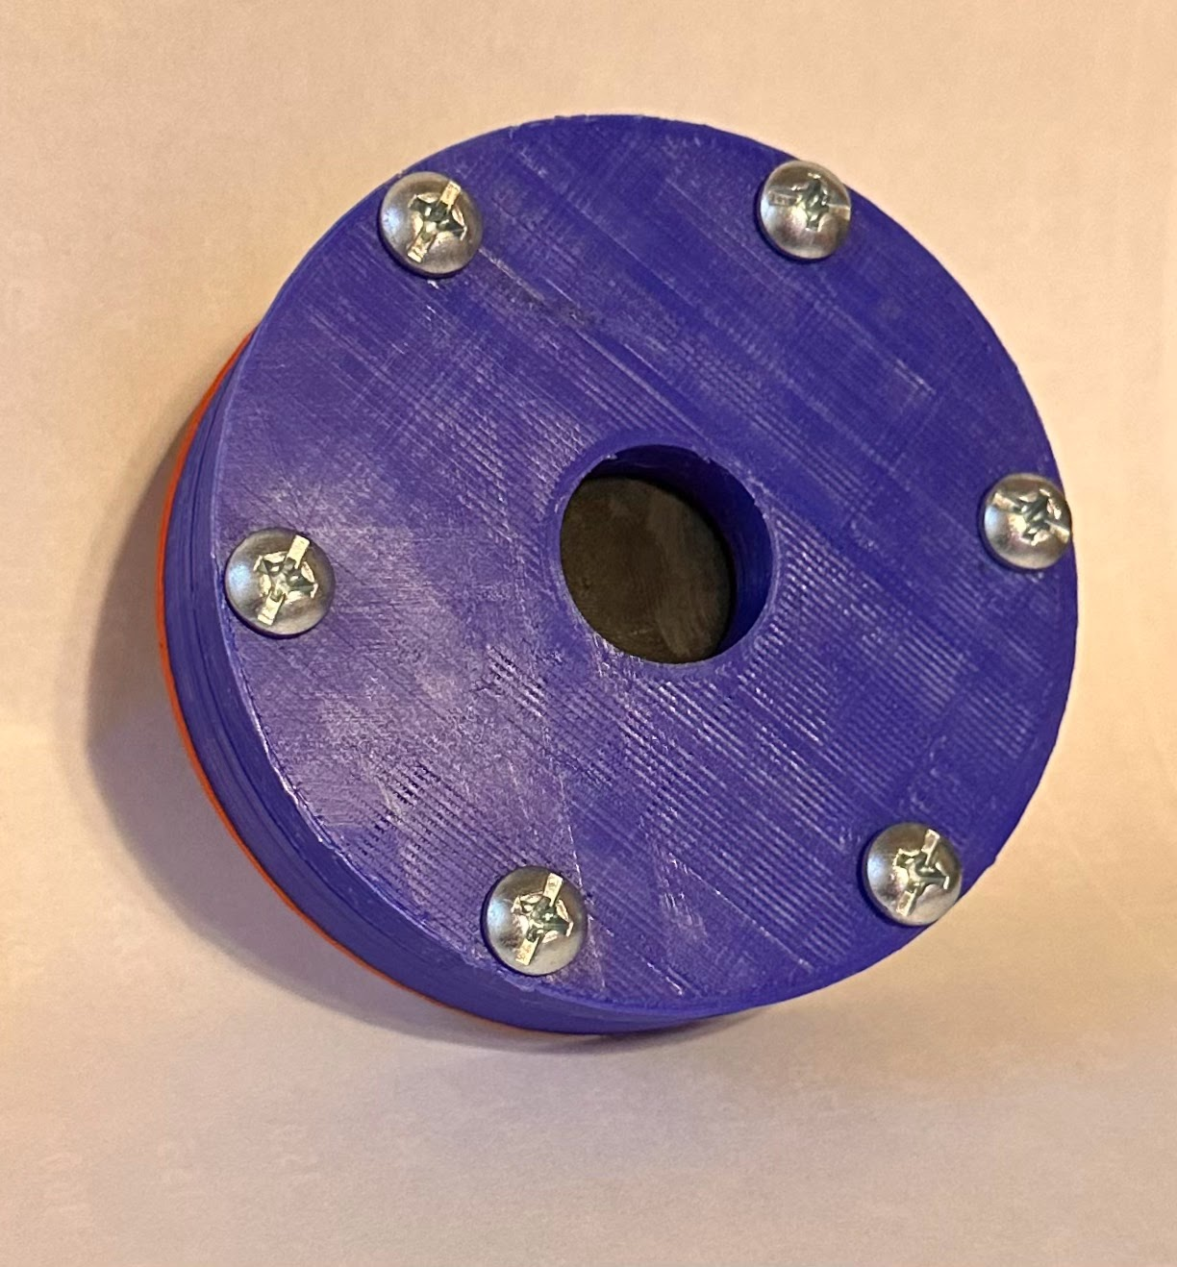
EPS Booth: 218
Elastomer Performance in Hydrogen Environment
Isabella Alvarado, Josh Kuriakose, Jordan Price, Michael O’Brien
Dr. J. Paramore (MSEN), Dr. R. Case (MSEN), BP America
Problem Definition
Hydrogen affects the properties of elastomers when under rapid compression and decompression cycles for long periods of time. This impacts the safety and long-term usability of elastomer seals in hydrogen processing equipment. Further study of this phenomenon would help model this degradation and help production of more durable, longer lasting elastomer seals.
Permeation Cell Design
We planned on placing a Viton disc inside of the test cell, and a flow sensor on the output. We planned to pressurize one side with hydrogen and measuring the flow rate on the other side of the cell. If we saw a measurable flow we would know that hydrogen is permeating the elastomer. TIme restrictions did not allow us to perform this experiment, and we only finished prototyping with 3D printing. Moving forward, we would cut the permeation cell from 316 Stainless Steel and incorporate it into the lab space.
Testing
First, we safety tested the setup with Argon to ensure we were clear to pressurize and heat the autoclave while connected to the tank. We placed the dog bones in the autoclave. We flushed out the Ar by vacuuming it out and then flushing it with hydrogen. We began aging by heating it up to 100 °C and pressurizing to 100 bar. We left the dogbones for about 56 hours. We collected them and tensile tested them along with a control group.
Table 1. UTS comparison between aged and control group.
Sample Number | Control UTS (MPa) | Aged UTS (MPa)
1 | 14.58 | 10.90
2 | 12.60 | 9.37
3 | 11.93 | 9.73
4 | 13.48 | 8.55
5 | 10.73 | 7.21
The control sample’s UTS is higher than the aged sample. The numerical data along with the stress vs. strain curve tells us that hydrogen does have an impact on the integrity of the Viton dog bones. ,.
Methodology
To test the effect of hydrogen on our elastomer (Viton), we tensile tested specimens before and after high-pressure, high-temperature aging in a hydrogen environment. We intended to test with rapid decompression cycles, but time restrictions didn’t allow.
Autoclave Design
The temperature-controlled pressure chamber we functionalized as an autoclave is a Parr mini reactor, with a hydrogen tank hook up and vacuum pump added to safely fill the reactor with hydrogen.
Outcomes
Impact & Future Work
We gathered data that proves that hydrogen affects elastomeric integrity. The samples were aged for a relatively short period of time and we still saw a significant decrease in integrity. In the future, we want to fabricate our permeation cell with SS 103 and characterize hydrogen permeability with elastomeric samples. We want to perform aging with an Arrhenius approach and predict elastomers’ lifespan in an industrial setting. Finally, we want to perform RGD with a safe setup including a regulator.
Figure 3. CAD design cross section showing inside of the permeation cell.
l
80 mm
60 mm
References
1) DES. Constant Temperature Accelerated Life Testing using the Arrhenius Relationship. Delserro Engineering Solutions. https://www.desolutions.com/blog/2013/08/constant-temperature-accelerated-life-testing-using-the-arrhenius-relationship/ (accessed 2023-03-02).
(2) Hydrogen for refineries is increasingly provided by industrial suppliers. https://www.eia.gov/todayinenergy/detail.php?id=24612 (accessed 2023-03-02).
(3) Wilson, M. A.; Frischknecht, A. L. High-Pressure Hydrogen Decompression in Sulfur Crosslinked Elastomers. Int. J. Hydrog. Energy 2022, 47 (33), 15094–15106. https://doi.org/10.1016/j.ijhydene.2022.03.015.
(4) Zhang, D.; Liu, W.; Qian, Y.; Que, J. Permeation of Hydrogen in Hastelloy C-276 Alloy at High Temperature. Fusion Sci. Technol. 2015, 67 (3), 681–684. https://doi.org/10.13182/FST14-T109.
(5) C-276.Pdf. https://www.haynesintl.com/docs/default-source/pdfs/new-alloy-brochures/corrosion-resistant-alloys/brochures/c-276.pdf (accessed 2022-12-07)
Figure 4.Control & Aged Samples. Stress vs.Strain Curves
Tensile Testing Results
Our results show a significant decrease in the ultimate tensile stress between the control group and the aged group. Exposure to high pressure hydrogen at elevated temperature for even as little as 2 days caused ~ 27.7% decrease in the fracture stress of the elastomer.
23 mm
Figure 2. Image of 3D printed permeation cell prototype
Acknowledgements
Thank you to BP for guidance. Thank you to Dr. Paramore for his lab space. Thank you to Dr. Case for guidance. ,
Figure 1. Schematic of full autoclave setup.

